Slide 1
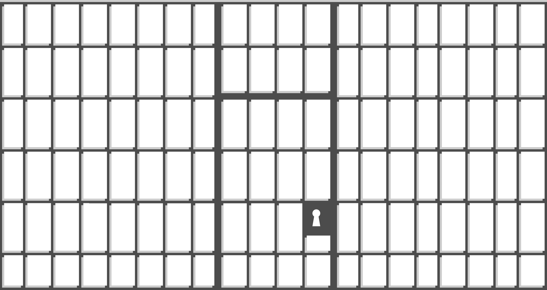
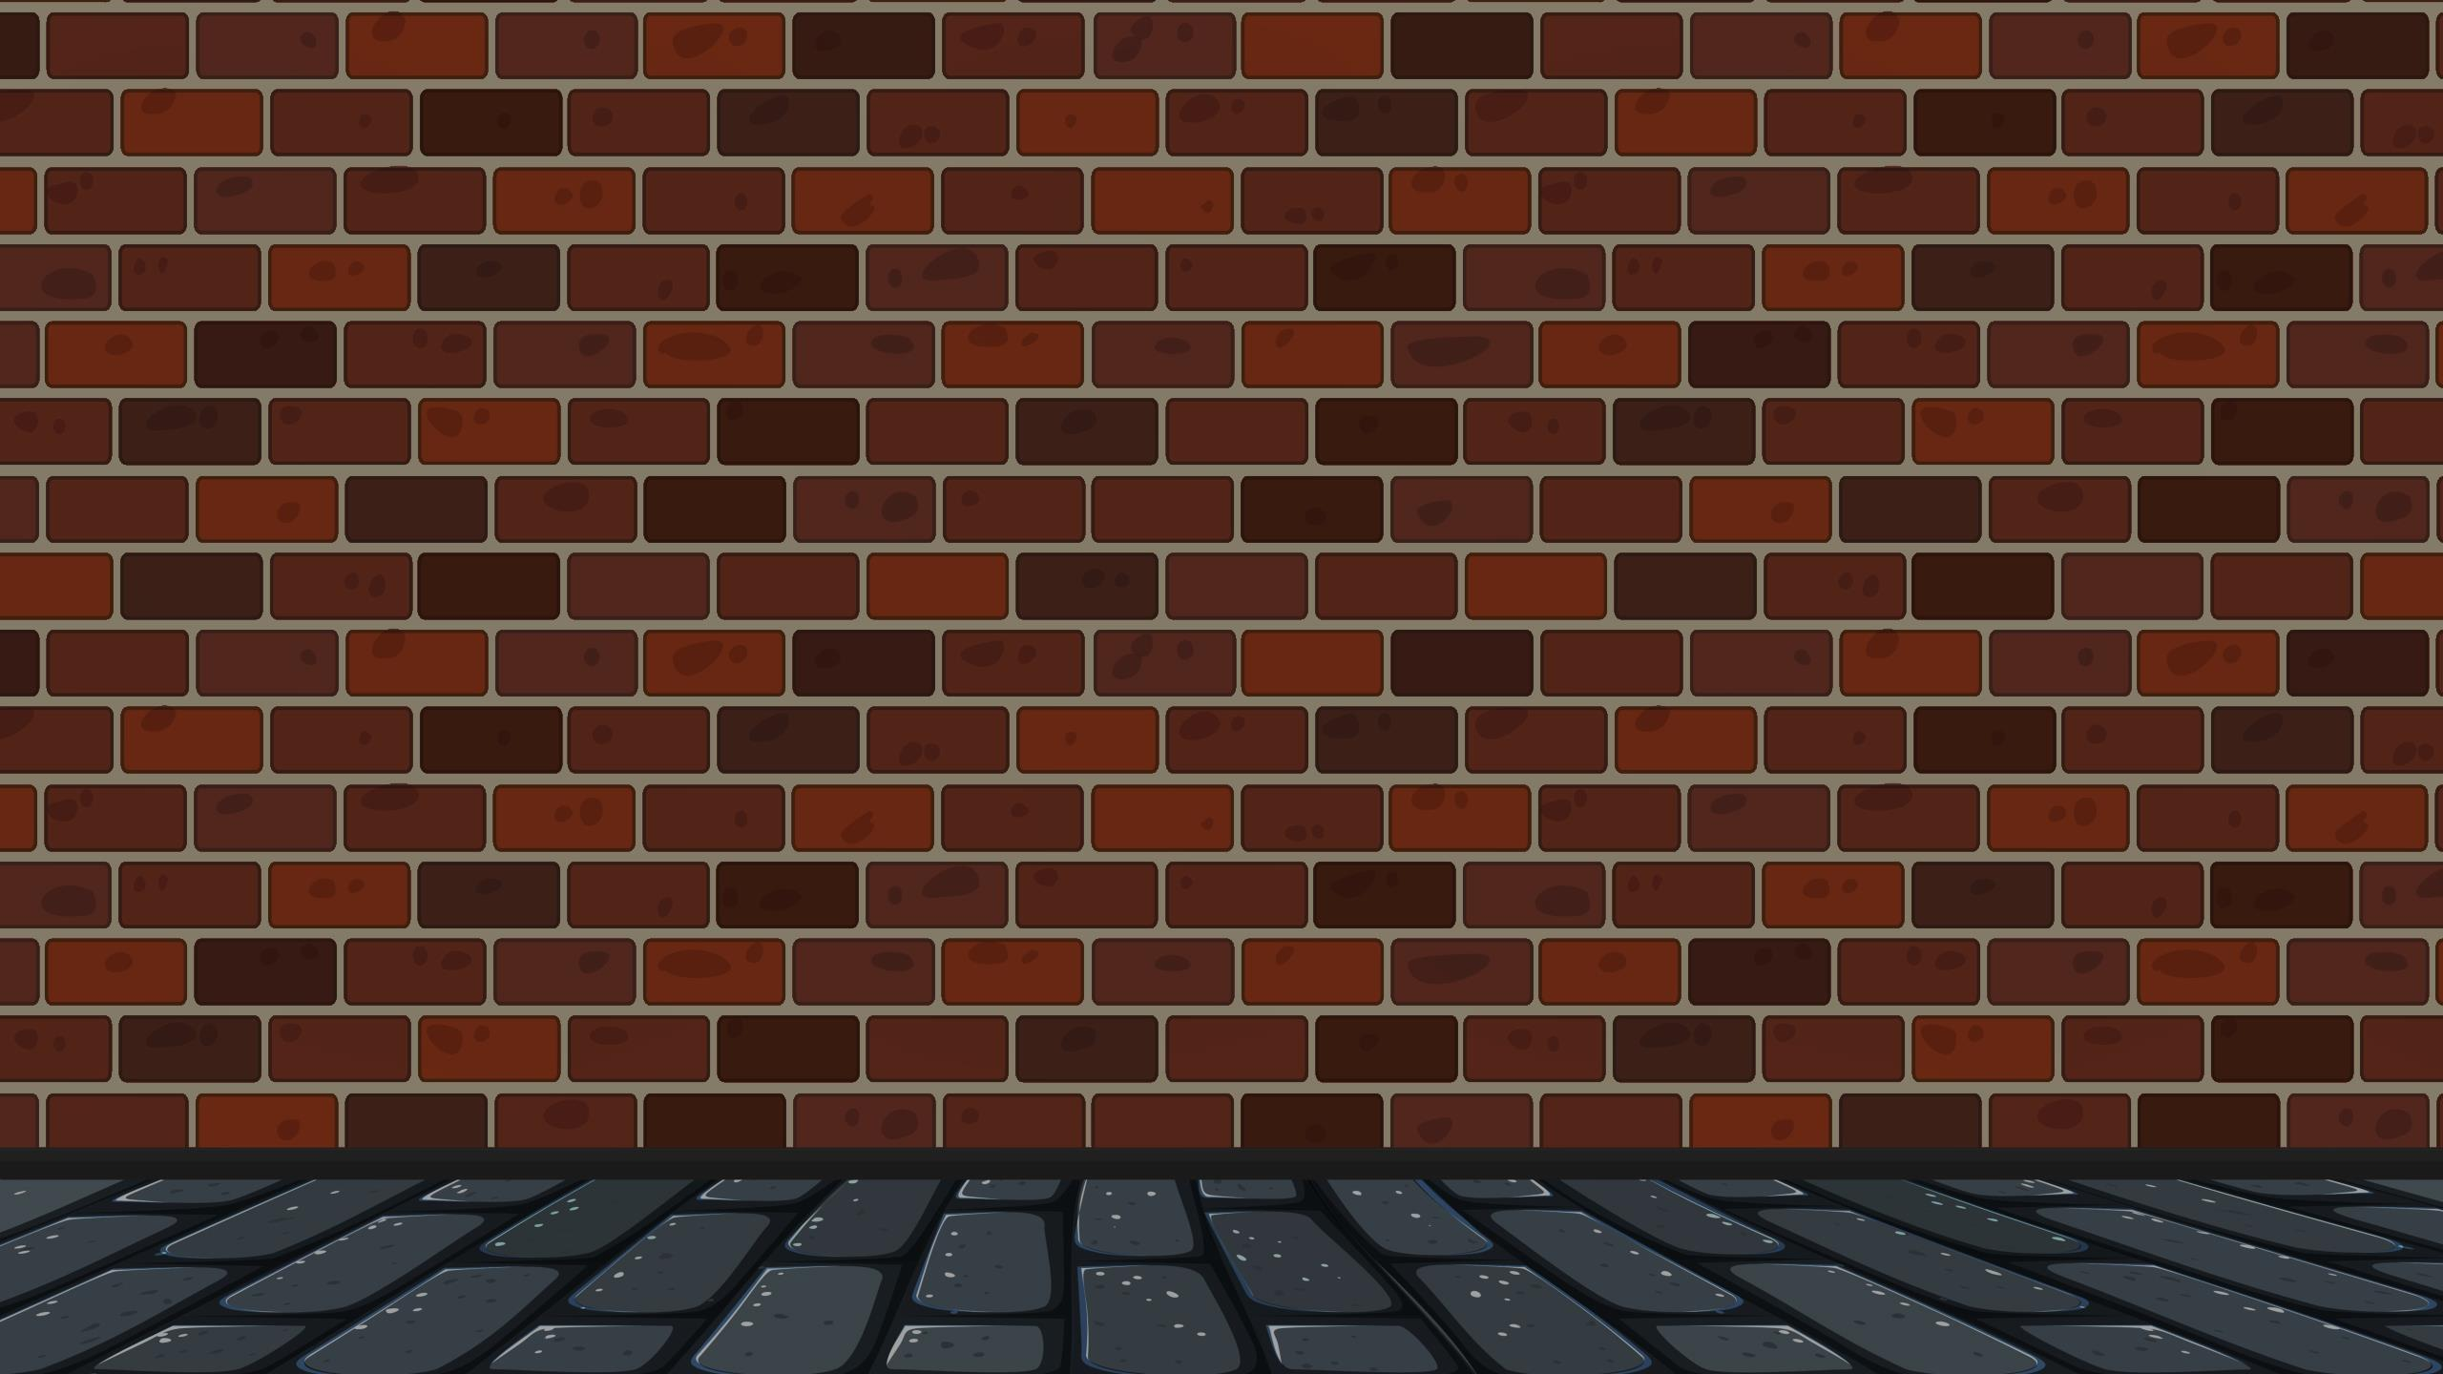






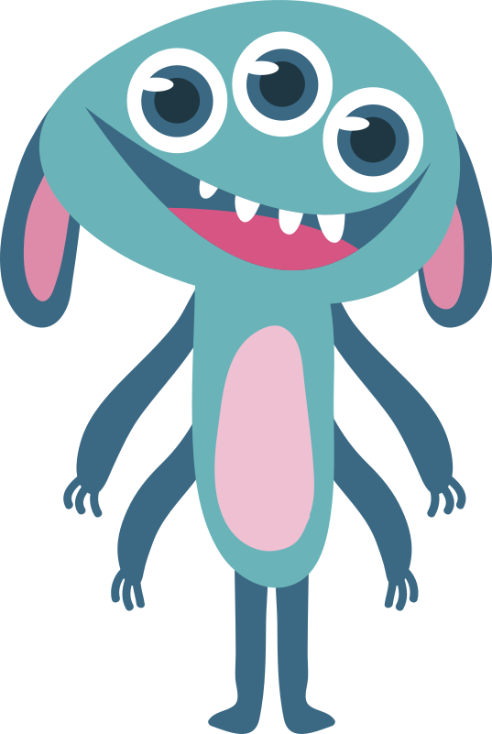






Notes:
Game and template design by Adam Groff. Game templates available at adamzero.wixsite.com/main. This template may be used, shared and redistributed for educational purposes, but may not be sold or posted to a site that seeks to profit from it (either through a subscription fee or a request for donations), by anyone other than its creator. All images and sounds are used in accordance with their respective licenses. Sounds may be re-used / redistributed according to their respective licenses. Images may not be re-used without an appropriate Freepik membership.
‘Professor Wülf’ is a fictional character- any resemblance, in name or appearance, with any other character or any real person, living or deceased, is coincidental.
Image Credits: All images from Freepik. Brick Wall- brgfx; Wood Texture- upklyak; Door- vectorpocket; Prison Bars- vector4stock; Door Frame, Bat / Purple Monsters- pch.vector; Green / Yellow Monsters- macrovector; All other monsters, scientist- anonymous Freepik contributors.
Sound Credits: All monster sounds and voices by Adam Groff and Ella Lee Groff (not for reuse without permission); All other sounds from freesound.org. Music- ‘Covert Operation’ by nicholasdaryl (CC0); Door Open- gabisaraceni (CCBY3.0); Lock- joedeshon (CCBY4.0); Metal Clicks (CC0), Fanfare (CCBY4.0)- Sheyvan
All fonts from Google Fonts (Open Font License)- Stardos Stencil, Cherry Bomb, Irish Grover (embedded)

Slide 2
Playing the Game: 10-20 minutes
The teacher reads words / sentences to the students, who write down the corresponding numbers (located above the images you place in the boxes) to make a ‘code’ (see the teacher’s printable code sheet on slide 16). Students who write the correct code (to ‘unlock’ the door and save the monsters) can then choose which door to open (by writing 1, 2, or 3 in their notebooks) to see how many points they get.
Although the game is intended as an individual exercise (as that motivates every student to listen and participate), it can easily be used as a team game if you think your students might struggle to get the correct code by themselves.
When running the game, click on the gold ‘tumblers’ to reveal each number in the code (you can also click the ‘Round ___’ button with the key at the bottom left to reveal all numbers at once). Scrolling or clicking elsewhere advances to the reward slide, then you can click on the doors to open them and show how many monsters students have saved.
Using This Template
Place your lesson images within the numbered boxes on any of the ‘Round ___’ game slides. You can then copy and paste those onto other slides, including the ‘How to Play’ Intro slide (slide 3). Unless you plan to skip the intro, be sure to replace the ‘Box 1’, ‘Box 2’, and Box 3’ word bubble text with the target language matching the images you placed in the corresponding boxes (you’ll need to zoom out or scroll right to see bubbles 2 and 3).
Slide 16 is a printable code sheet for the teacher, which you can edit to include the words/sentences you will use rather than just the numbers (if you’re willing to trade extra prep time for making the game easier for you to run).
Slides 18-30 are an entirely alternate set of codes and reward slides to allow multiple uses of the game with the same group of students. To use those, just ‘shift+click’ them to select them all, right-click one, and uncheck ‘hide slide’ (you can repeat that process with the original slides 4-16 to hide them, instead).
NOTE- Moving or deleting objects can break animation sequences, so I recommend keeping an unaltered copy of this template in a separate folder as a back-up.
Notes:
Game and template design by Adam Groff.

Slide 3
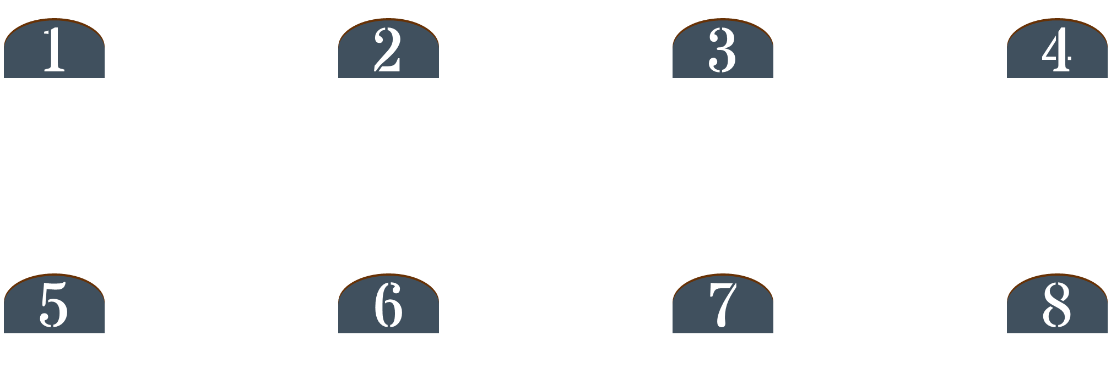



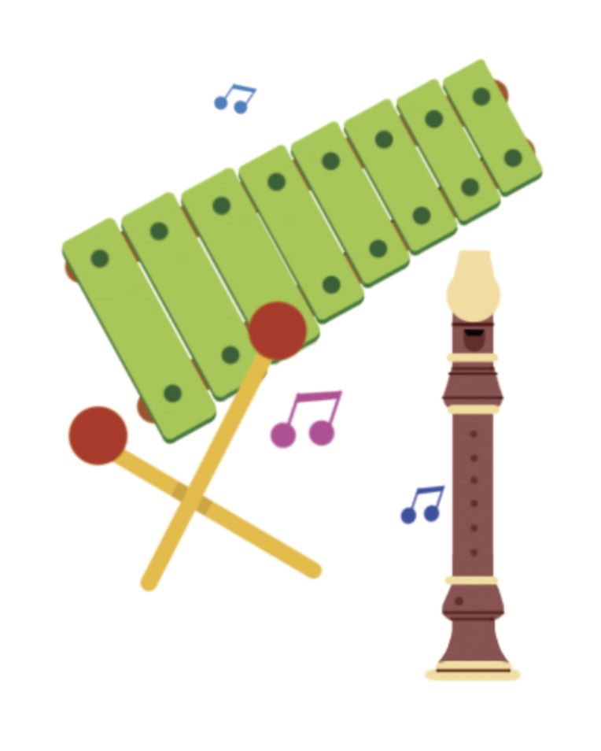


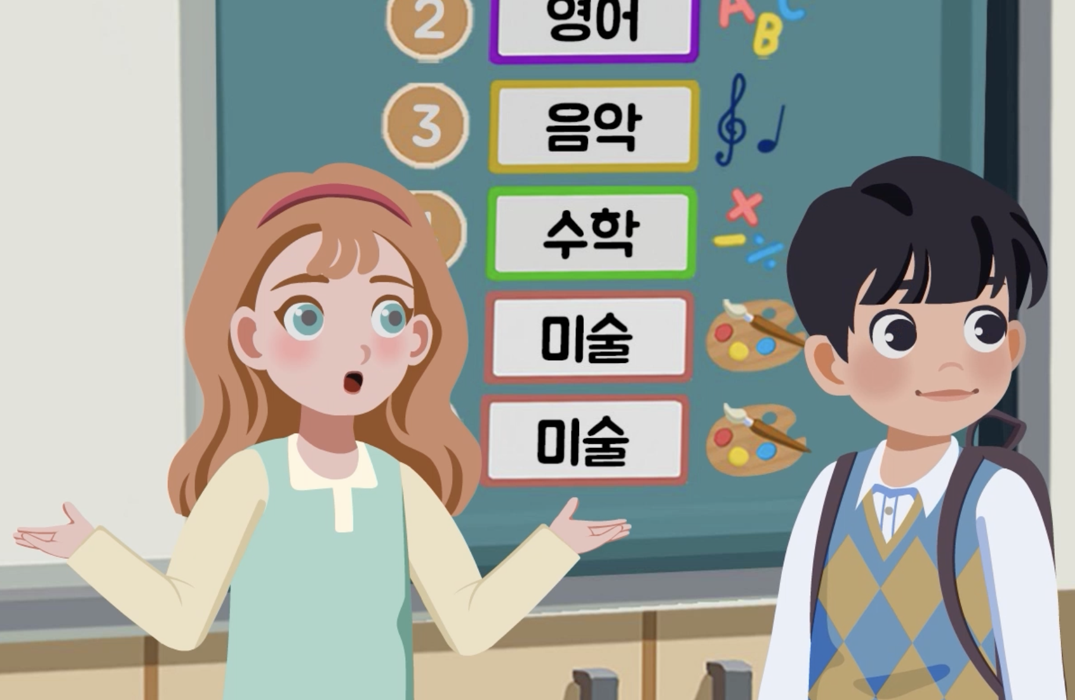
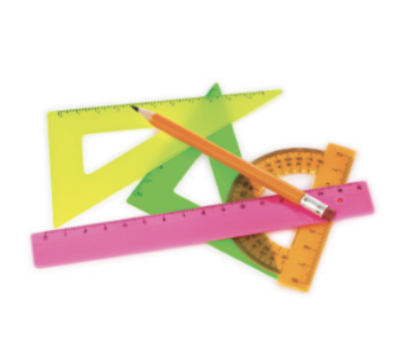
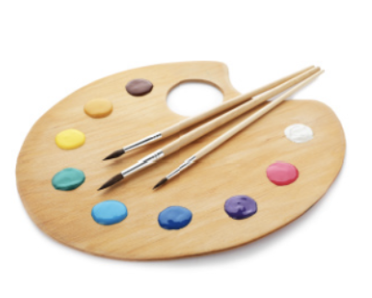
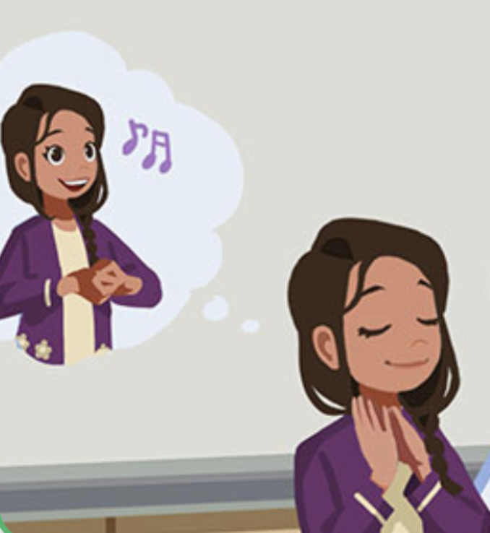
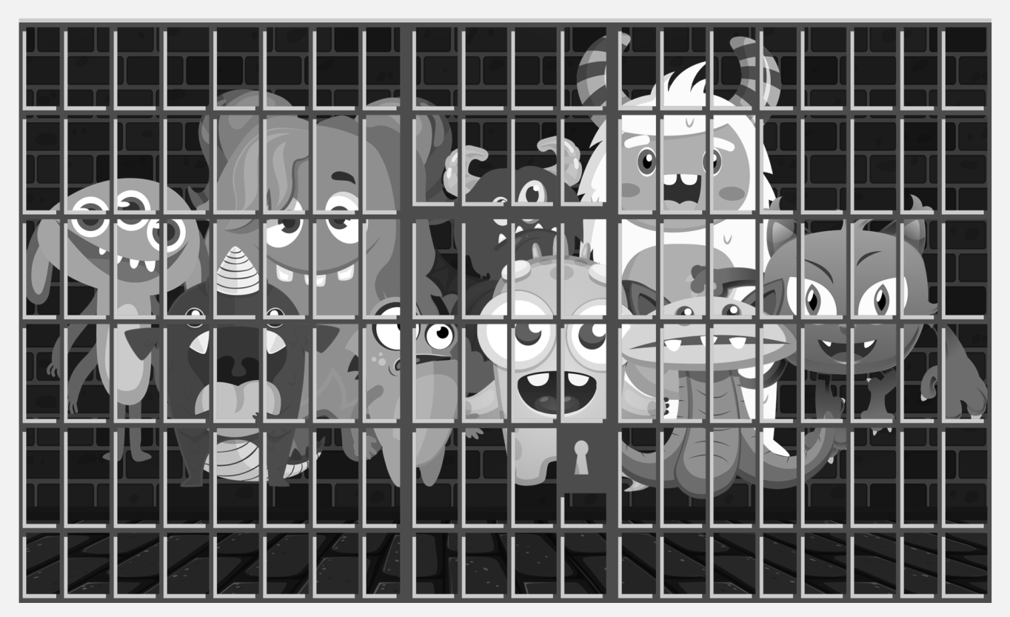
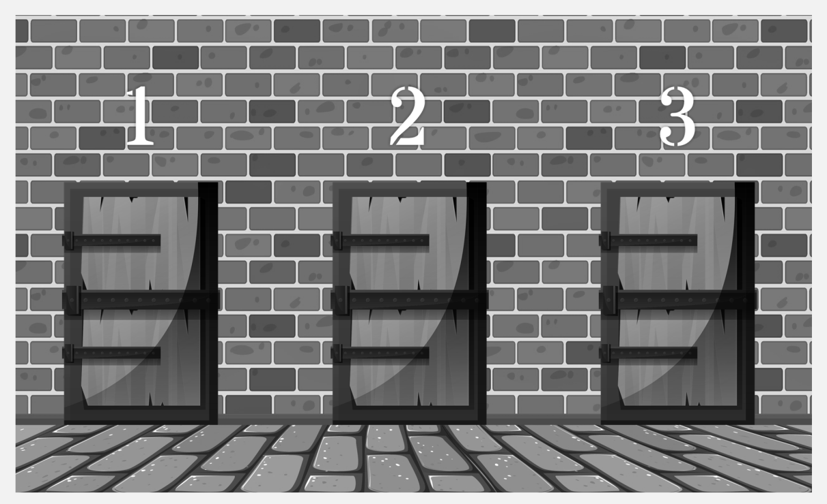
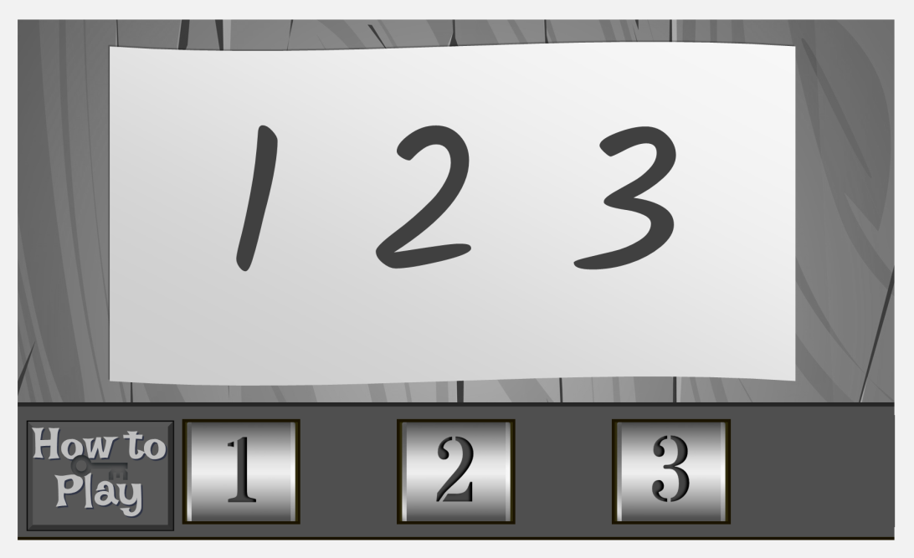

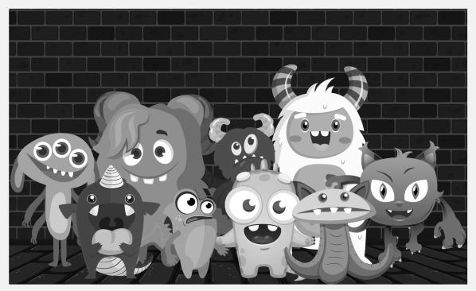
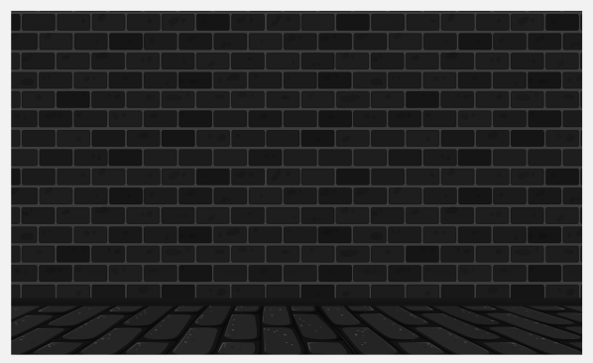






I will study these monsters…
… and then… Hahahahaha!
Box 1
Box 2
Box 3
… you can choose a door to open.
Save more monsters for more points!
Save them from the evil Professor Wülf!
… you can check the code.
When you have all of the numbers…
How to Play
If you wrote the correct numbers…
These nice monsters
are in trouble!
Good
luck!
… then write the number.
Listen to your teacher…
Notes:
Game Introduction- Place your lesson images inside the numbered boxes, then write the target language for boxes 1, 2, and 3 in the word bubbles (to the right of the slide- zoom out to see bubbles 2 and 3). Once you have read the target words / sentences, click on the gold tumblers at the bottom to show the code for this round (1 2 3 for this intro slide). (You can also click on the ‘Round’ button to immediately reveal all numbers.) NOTE- moving or deleting objects (other than your lesson images) can break animation sequences. Game and template design by Adam Groff.

Slide 4
Round One
Notes:
Round One – Code: 7 4 8 - Place your lesson images inside the numbered boxes. Once you have read the target words / sentences, click on the gold tumblers at the bottom to show the code for this round. (You can also click on the ‘Round’ button to immediately reveal all numbers.) NOTE- moving or deleting objects (other than your lesson images) can break animation sequences. Game and template design by Adam Groff.

Slide 5
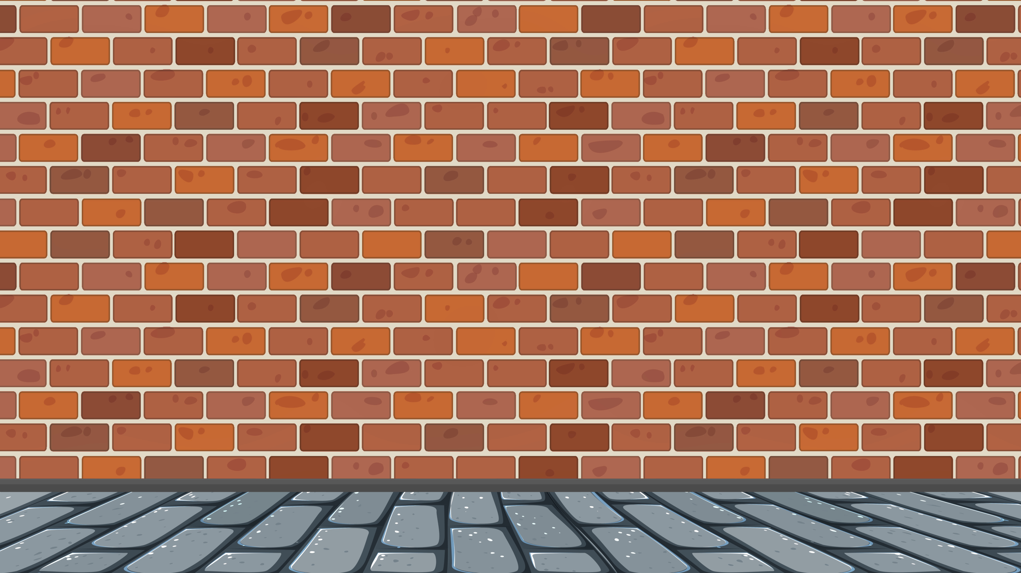











3
2
4
Notes:
Reward Slide – 3 2 4; Click on a door to reveal the points. NOTE- moving or deleting objects can break animation sequences. Game and template design by Adam Groff.

Slide 6
Round Two
Notes:
Round Two – Code: 6 3 2 7 - Place your lesson images inside the numbered boxes. Once you have read the target words / sentences, click on the gold tumblers at the bottom to show the code for this round. (You can also click on the ‘Round’ button to immediately reveal all numbers.) NOTE- moving or deleting objects (other than your lesson images) can break animation sequences. Game and template design by Adam Groff.

Slide 7
1
4
4
Notes:
Reward Slide – 1 4 4; Click on a door to reveal the points. NOTE- moving or deleting objects can break animation sequences. Game and template design by Adam Groff.

Slide 8
Round Three
Notes:
Round Three – Code: 5 7 1 4 - Place your lesson images inside the numbered boxes. Once you have read the target words / sentences, click on the gold tumblers at the bottom to show the code for this round. (You can also click on the ‘Round’ button to immediately reveal all numbers.) NOTE- moving or deleting objects (other than your lesson images) can break animation sequences. Game and template design by Adam Groff.

Slide 9
5
3
1
Notes:
Reward Slide – 5 3 1; Click on a door to reveal the points. NOTE- moving or deleting objects can break animation sequences. Game and template design by Adam Groff.

Slide 10
Round Four
Notes:
Round Four – Code: 3 8 4 5 2 - Place your lesson images inside the numbered boxes. Once you have read the target words / sentences, click on the gold tumblers at the bottom to show the code for this round. (You can also click on the ‘Round’ button to immediately reveal all numbers.) NOTE- moving or deleting objects (other than your lesson images) can break animation sequences. Game and template design by Adam Groff.

Slide 11
2
4
3
Notes:
Reward Slide – 2 4 3; Click on a door to reveal the points. NOTE- moving or deleting objects can break animation sequences. Game and template design by Adam Groff.

Slide 12
Round Five
Notes:
Round Five – Code: 2 5 3 1 6 - Place your lesson images inside the numbered boxes. Once you have read the target words / sentences, click on the gold tumblers at the bottom to show the code for this round. (You can also click on the ‘Round’ button to immediately reveal all numbers.) NOTE- moving or deleting objects (other than your lesson images) can break animation sequences. Game and template design by Adam Groff.

Slide 13
4
3
2
Notes:
Reward Slide – 4 3 2; Click on a door to reveal the points. NOTE- moving or deleting objects can break animation sequences. Game and template design by Adam Groff.

Slide 14
Round Six
Notes:
Round Six – Code: 8 2 6 7 4 1 - Place your lesson images inside the numbered boxes. Once you have read the target words / sentences, click on the gold tumblers at the bottom to show the code for this round. (You can also click on the ‘Round’ button to immediately reveal all numbers.) NOTE- moving or deleting objects (other than your lesson images) can break animation sequences. Game and template design by Adam Groff.

Slide 15
2
2
5
Notes:
Reward Slide – 2 2 5; Click on a door to reveal the points. NOTE- moving or deleting objects can break animation sequences. Game and template design by Adam Groff.

Slide 16
Teacher’s Code Sheet
One: 7 → 4 → 8
Two: 6 → 3 → 2 → 7
Three: 5 → 7 → 1 → 4
Four: 3 → 8 → 4 → 5 → 2
Five: 2 → 5 → 3 → 1 → 6
Six: 8 → 2 → 6 → 7 → 4 → 1
Notes:
Teacher’s Printable Code Sheet- You can replace the numbers with the words / sentences you want to say for easier use during class.

Slide 17


Good Job!
Game and template design by Adam Groff
Image Credits
All images from Freepik.
Brick Wall- brgfx Wood Texture- upklyak
Image Credits
Door- vectorpocket Prison Bars- vector4stock
Door Frame, Bat / Purple Monsters- pch.vector
Green / Yellow Monsters- macrovector
Image Credits
All other monsters, Scientist- anonymous Freepik contributors
Sound Credits
All monster sounds and voices by Adam Groff and Ella Lee Groff
Sound Credits
All other sounds from freesound.org.
Music- ‘Covert Operation’ by nicholasdaryl (CC0)
Sound Credits
Door Open- gabisaraceni (CCBY3.0)
Lock- joedeshon (CCBY4.0)
Metal Clicks (CC0), Fanfare (CCBY4.0) - Sheyvan
All fonts from Google Fonts (Open Font License)- Stardos Stencil, Cherry Bomb, Irish Grover
Where are all of my monsters?!
Notes:
Credits Slide – Game and template design by Adam Groff. Game templates available at adamzero.wixsite.com/main. This template may be used, shared and redistributed for educational purposes, but may not be sold or posted to a site that seeks to profit from it (either through a subscription fee or a request for donations), by anyone other than its creator. All images and sounds are used in accordance with their respective licenses. Sounds may be re-used / redistributed according to their respective licenses. Images may not be re-used without an appropriate Freepik membership.
‘Professor Wülf’ is a fictional character- any resemblance, in name or appearance, with any other character or any real person, living or deceased, is coincidental.
Image Credits: All images from Freepik. Brick Wall- brgfx; Wood Texture- upklyak; Door- vectorpocket; Prison Bars- vector4stock; Door Frame, Bat / Purple Monsters- pch.vector; Green / Yellow Monsters- macrovector; All other monsters, scientist- anonymous Freepik contributors.
Sound Credits: All monster sounds and voices by Adam Groff and Ella Lee Groff (not for reuse without permission); All other sounds from freesound.org. Music- ‘Covert Operation’ by nicholasdaryl (CC0); Door Open- gabisaraceni (CCBY3.0); Lock- joedeshon (CCBY4.0); Metal Clicks (CC0), Fanfare (CCBY4.0)- Sheyvan
All fonts from Google Fonts (Open Font License)- Stardos Stencil, Cherry Bomb, Irish Grover (embedded)

Slide 18
Round One
Notes:
(Alt) Round One – Code: 8 6 3 - Place your lesson images inside the numbered boxes. Once you have read the target words / sentences, click on the gold tumblers at the bottom to show the code for this round. (You can also click on the ‘Round’ button to immediately reveal all numbers.) NOTE- moving or deleting objects (other than your lesson images) can break animation sequences. Game and template design by Adam Groff.

Slide 19
1
5
3
Notes:
(Alt) Reward Slide – 1 5 3; Click on a door to reveal the points. NOTE- moving or deleting objects can break animation sequences. Game and template design by Adam Groff.

Slide 20
Round Two
Notes:
(Alt) Round Two – Code: 2 1 3 8 - Place your lesson images inside the numbered boxes. Once you have read the target words / sentences, click on the gold tumblers at the bottom to show the code for this round. (You can also click on the ‘Round’ button to immediately reveal all numbers.) NOTE- moving or deleting objects (other than your lesson images) can break animation sequences. Game and template design by Adam Groff.

Slide 21
3
4
2
Notes:
(Alt) Reward Slide – 3 4 2; Click on a door to reveal the points. NOTE- moving or deleting objects can break animation sequences. Game and template design by Adam Groff.

Slide 22
Round Three
Notes:
(Alt) Round Three – Code: 6 4 5 3 - Place your lesson images inside the numbered boxes. Once you have read the target words / sentences, click on the gold tumblers at the bottom to show the code for this round. (You can also click on the ‘Round’ button to immediately reveal all numbers.) NOTE- moving or deleting objects (other than your lesson images) can break animation sequences. Game and template design by Adam Groff.

Slide 23
4
1
4
Notes:
(Alt) Reward Slide – 4 1 4; Click on a door to reveal the points. NOTE- moving or deleting objects can break animation sequences. Game and template design by Adam Groff.

Slide 24
Round Four
Notes:
(Alt) Round Four – Code: 1 7 8 3 2 - Place your lesson images inside the numbered boxes. Once you have read the target words / sentences, click on the gold tumblers at the bottom to show the code for this round. (You can also click on the ‘Round’ button to immediately reveal all numbers.) NOTE- moving or deleting objects (other than your lesson images) can break animation sequences. Game and template design by Adam Groff.

Slide 25
5
2
2
Notes:
(Alt) Reward Slide – 5 2 2; Click on a door to reveal the points. NOTE- moving or deleting objects can break animation sequences. Game and template design by Adam Groff.

Slide 26
Round Five
Notes:
(Alt) Round Five – Code: 4 2 7 8 5 - Place your lesson images inside the numbered boxes. Once you have read the target words / sentences, click on the gold tumblers at the bottom to show the code for this round. (You can also click on the ‘Round’ button to immediately reveal all numbers.) NOTE- moving or deleting objects (other than your lesson images) can break animation sequences. Game and template design by Adam Groff.

Slide 27
3
1
5
Notes:
(Alt) Reward Slide – 3 1 5; Click on a door to reveal the points. NOTE- moving or deleting objects can break animation sequences. Game and template design by Adam Groff.

Slide 28
Round Six
Notes:
(Alt) Round Six – Code: 7 5 1 6 3 4 - Place your lesson images inside the numbered boxes. Once you have read the target words / sentences, click on the gold tumblers at the bottom to show the code for this round. (You can also click on the ‘Round’ button to immediately reveal all numbers.) NOTE- moving or deleting objects (other than your lesson images) can break animation sequences. Game and template design by Adam Groff.

Slide 29
4
4
1
Notes:
(Alt) Reward Slide – 4 4 1; Click on a door to reveal the points. NOTE- moving or deleting objects can break animation sequences. Game and template design by Adam Groff.

Slide 30
Teacher’s Code Sheet 2 (For Alternate Slides)
One: 8 → 6 → 3
Two: 2 → 1 → 3 → 8
Three: 6 → 4 → 5 → 3
Four: 1 → 7 → 8 → 3 → 2
Five: 4 → 2 → 7 → 8 → 5
Six: 7 → 5 → 1 → 6 → 3 → 4
Notes:
(Alternate) Teacher’s Printable Code Sheet- You can replace the numbers with the words / sentences you want to say for easier use during class.

